Slide 1
UNIQ+ R COURSE
Thursday 6th July
Oxford 2023

Slide 2
MORNING
Superhero dataset
Work on your own: research questions
Plotting with R
Plotting with ggplot2
AFTERNOON
Handling missing values
Conditionals
Loops
Exercise and discussion
Oxford 2023

Slide 3
HERO DATASET
Thursday 6th July
Oxford 2023

Slide 4
Superhero dataset
Let´s practice what we learnt yesterday!
Explore data
What type of variables we have?
Do they make sense?
Is there any missing data?
Use what you learnt yesterday
Brainstorm some scientific questions
Try to answer them!
Oxford 2023

Slide 5

Let´s practice!
Image by lucabravo on Freepik

Slide 6
DATA VISUALISATION
Thursday 6th July
Oxford 2023

Slide 7
Plotting with R
Easy to visualize data
What do we want to visualize?:
Do we need detailed info (see every data point) or just mean/median or distribution?
What type of data we have?
Scale?
Colours?
Legend?
Important to understand basic concepts (e.g., how to call variables of df)
Oxford 2023

Slide 8
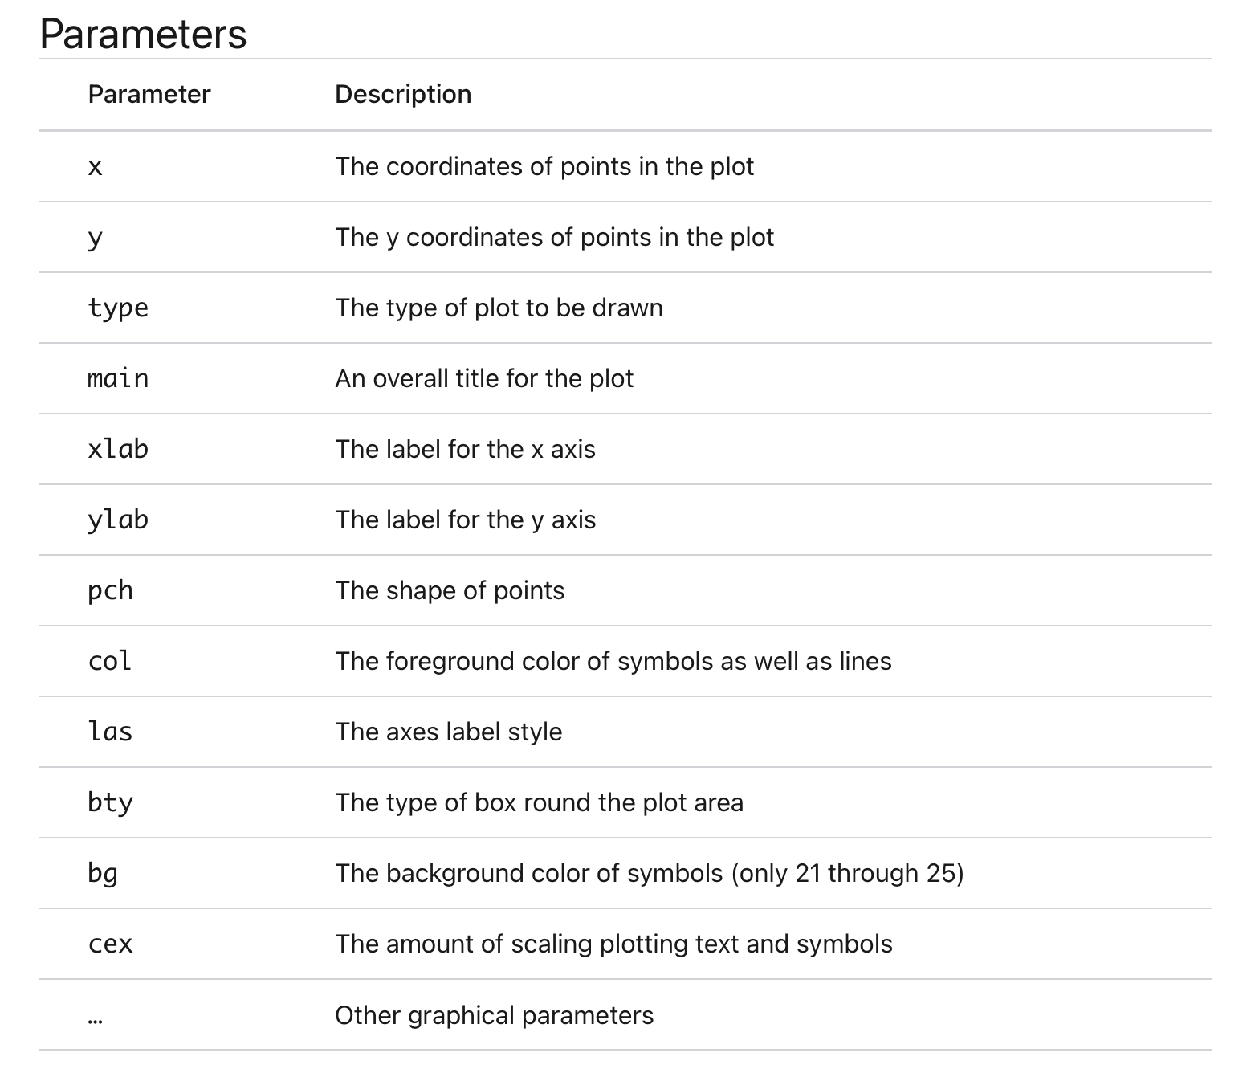
Basic R plotting
Function plot() is not a single defined function. Generic function. The exact function being called will depend on the parameters used.
Oxford 2023

Slide 9
Basic R plotting
Type of graph | Command
Histogram | hist()
Boxplot | boxplot()
Scatterplot | plot()
Pairwise correlation | pairs()
Arguments matter…
Arguments | Plot
plot(x,y) | Scatterplot of x and y numeric vectors
plot(factor) | Barplot of the factor
plot(factor,y) | Boxplot of the numeric vector and the levels of the factor
plot(df) | Correlation plot of all dataframe columns
Oxford 2023

Slide 10
Categorical data / factors
Data that can be separated into categories. e.g., race, sex or educational level.
We can convert data using as.factor().
Oxford 2023

Slide 11
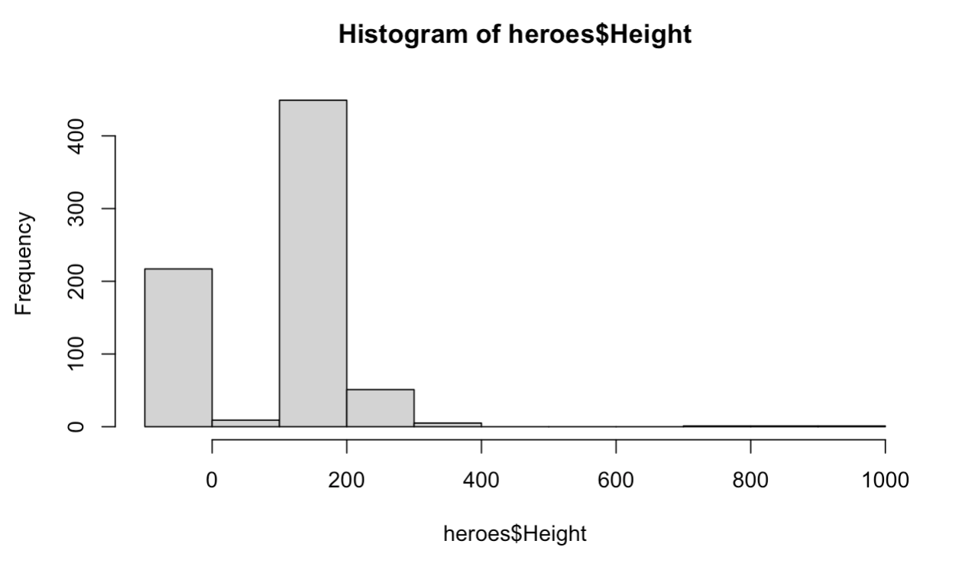
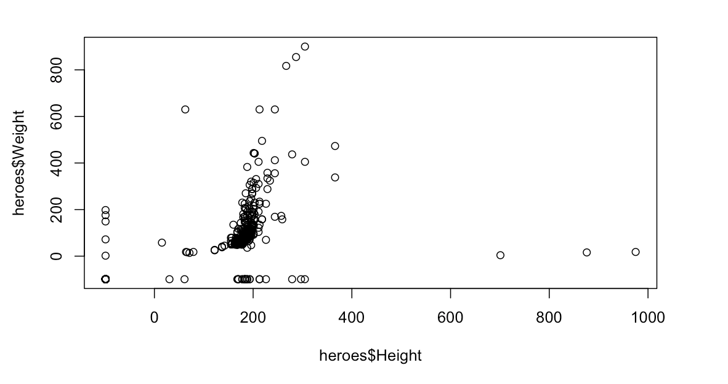
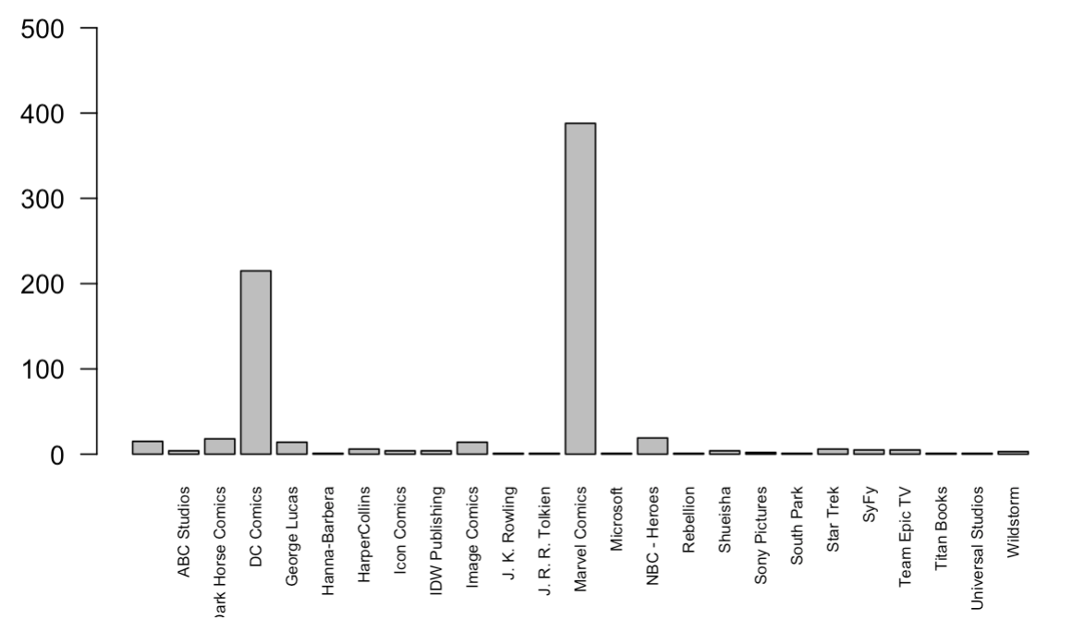
Basic R plotting
hist(heroes$Height)
plot(heroes$Height, heroes$Weight)
plot(heroes$Publisher)
Oxford 2023

Slide 12
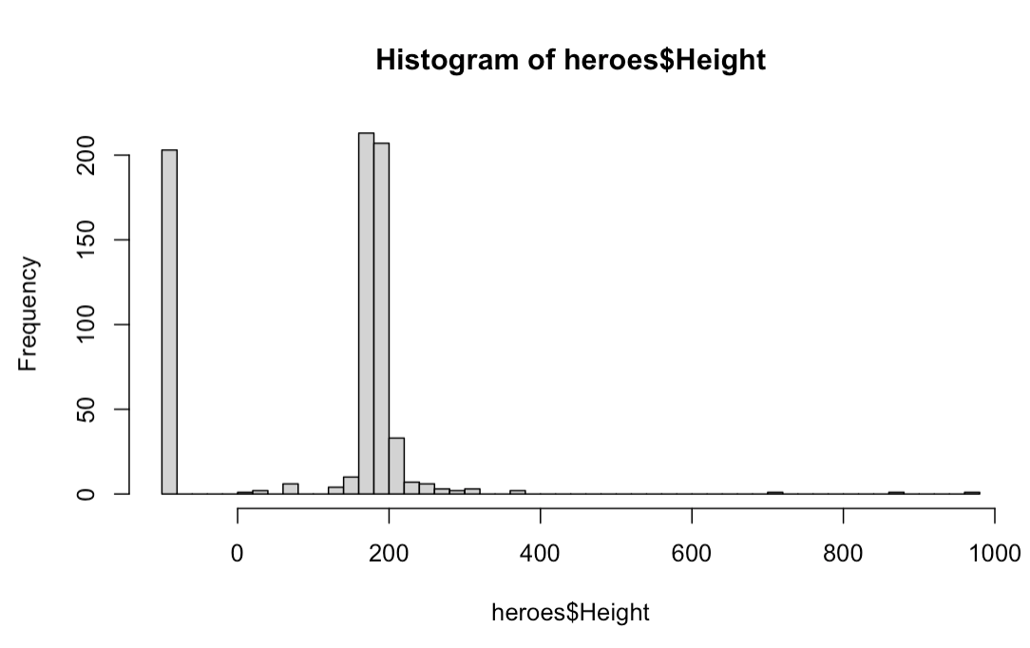
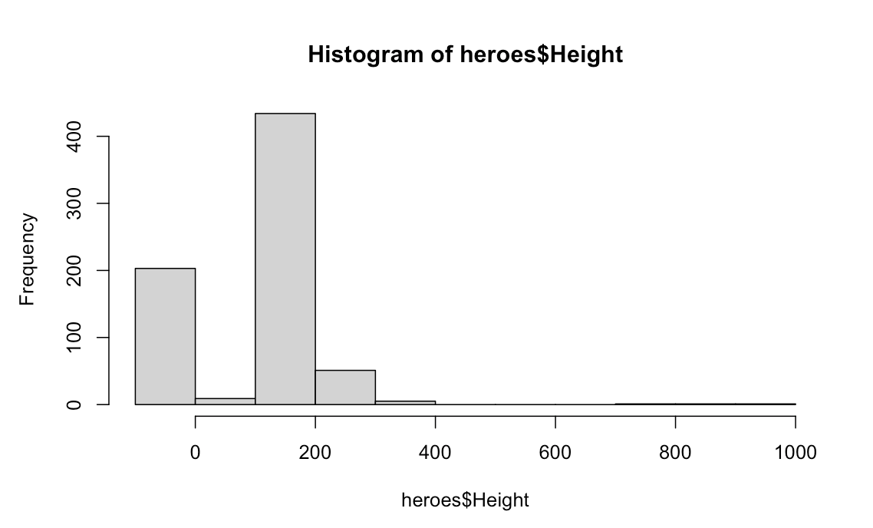
Basic R plotting: histogram
hist(heroes$Height)
hist(heroes$Height, breaks=50)
Oxford 2023

Slide 13
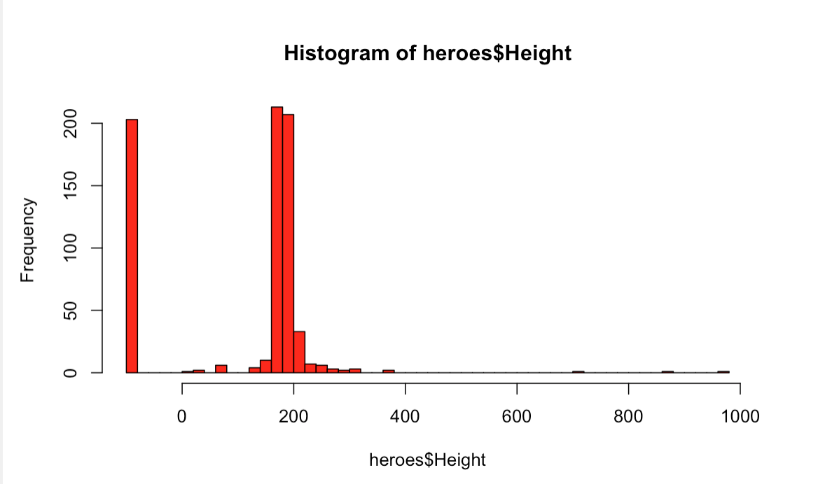
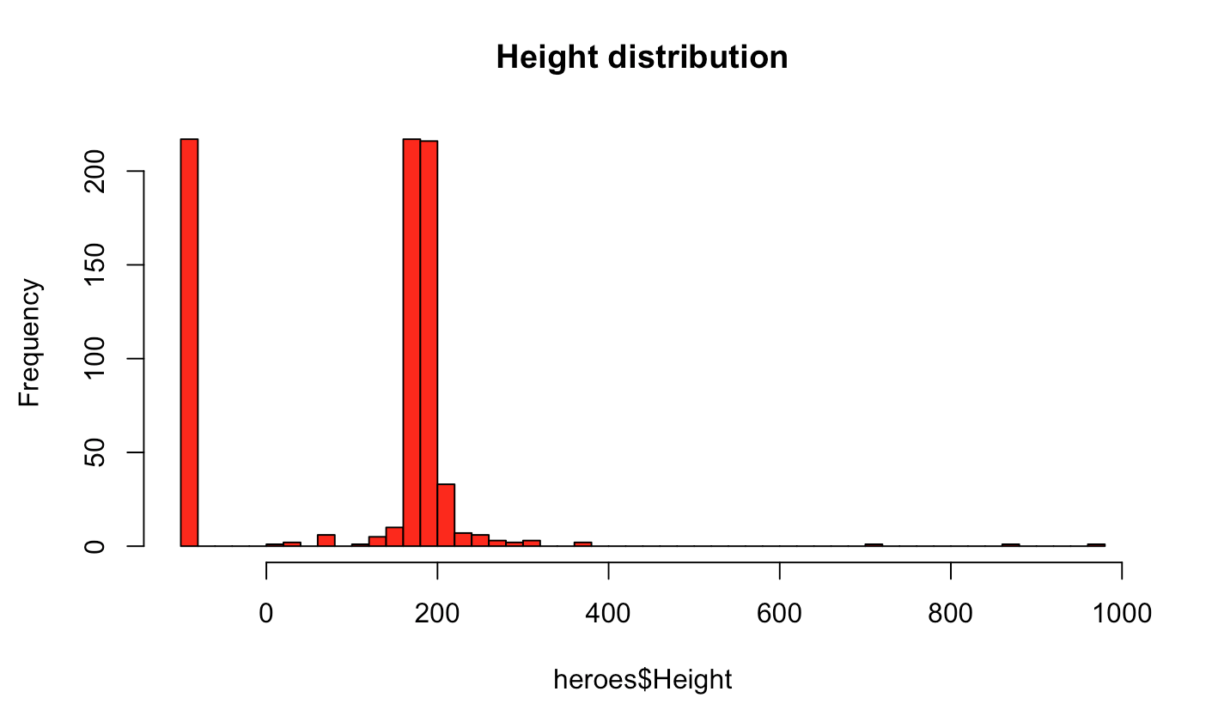
Basic R plotting: histogram
hist(heroes$Height, breaks=50, col= “red”)
hist(heroes$Height, breaks=50, col= “red”, main = ”Height distribution”)
Oxford 2023

Slide 14
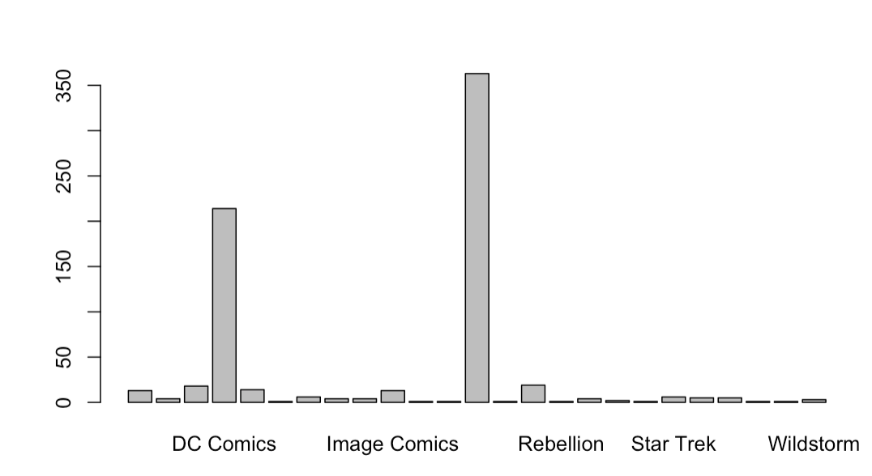
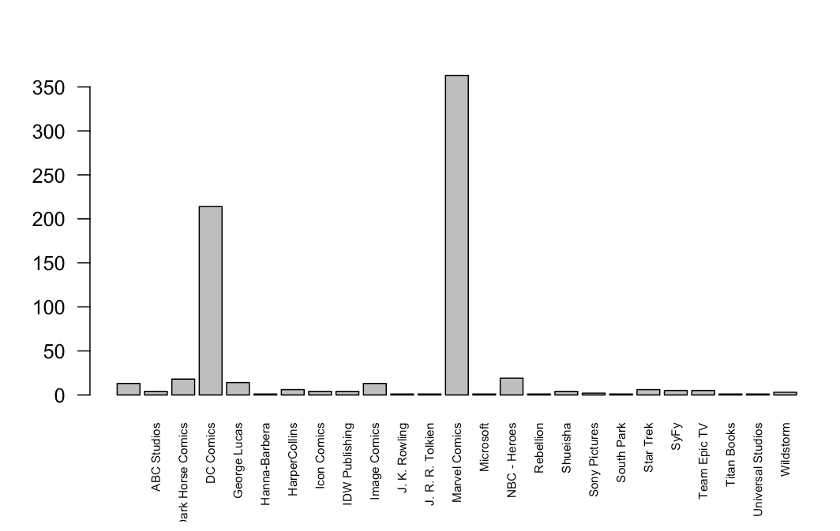
Basic R plotting: barplots
plot(heroes$Publisher)
plot(heroes$Publisher, las=2)
Oxford 2023

Slide 15
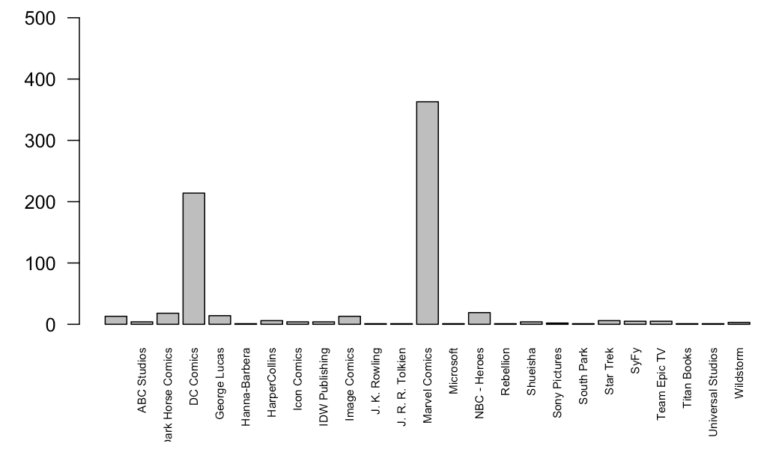
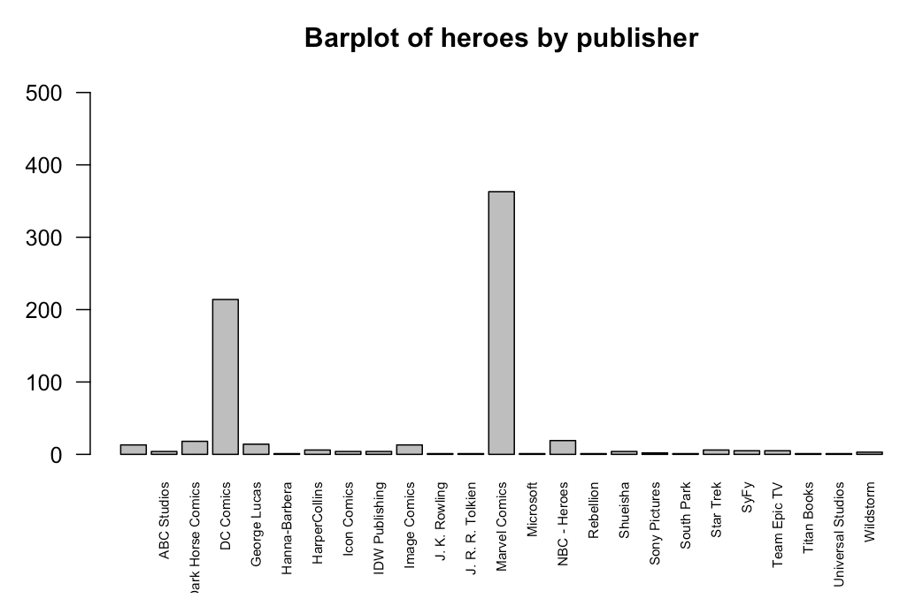
Basic R plotting: barplots
plot(heroes$Publisher, las=2, ylim= = c(0,500))
plot(heroes$Publisher, las=2, ylim= c(0,500), main = "Barplot of heroes by publisher")
TAKE HOME MESSAGE:
YOU NEED TO KNOW ALL YOU CAN DO BUT YOU DON´T NEED TO KNOW ALL
Oxford 2023

Slide 16
Basic R plotting: scatterplot
plot(heroes$Height, heroes$Weight)
Oxford 2023

Slide 17
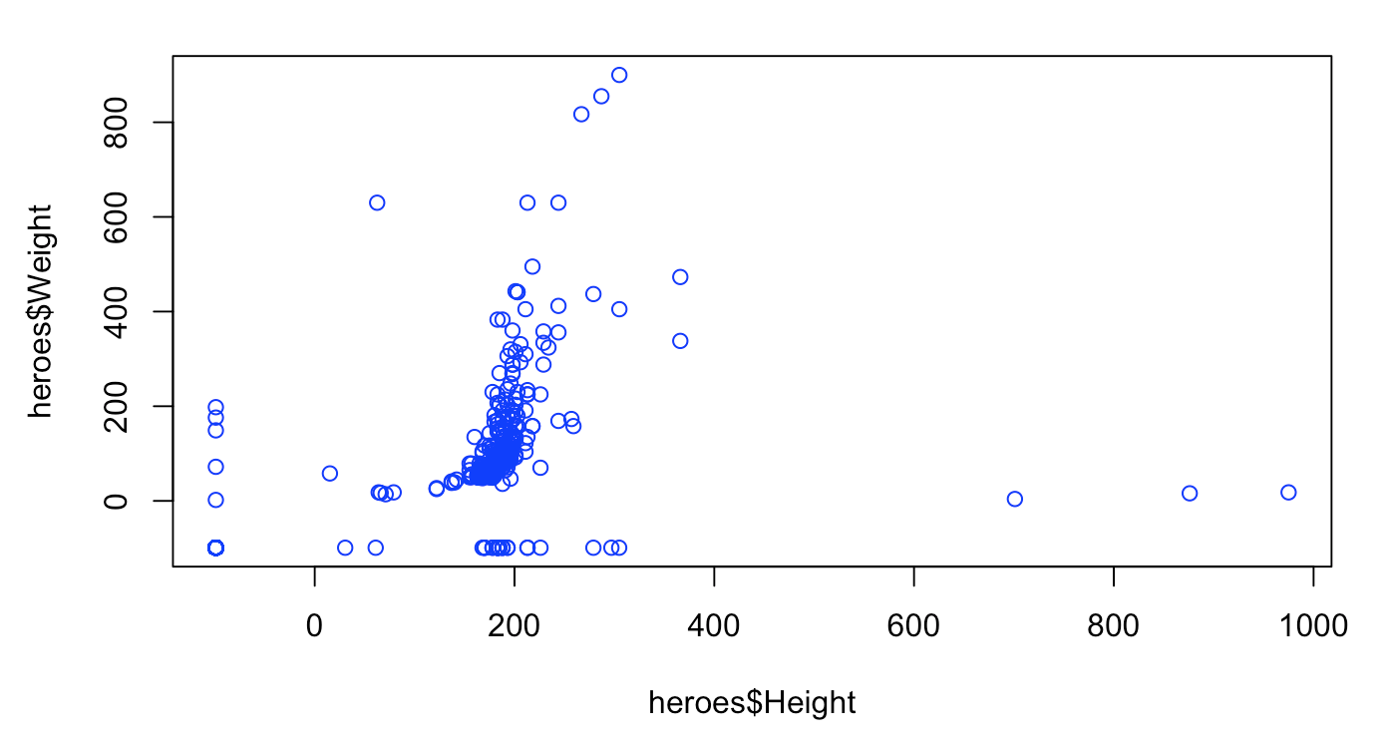
Basic R plotting: scatterplot
plot(heroes$Height, heroes$Weight, col=“blue”)
Oxford 2023

Slide 18
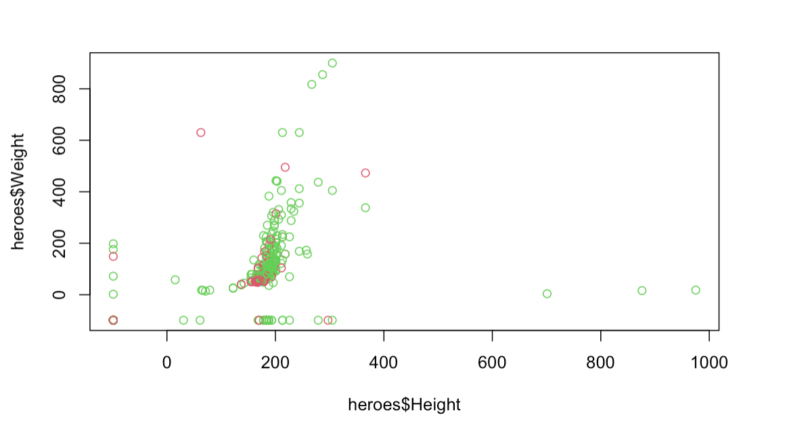
Basic R plotting: scatterplot
plot(heroes$Height, heroes$Weight, col=heroes$Gender)
Oxford 2023

Slide 19
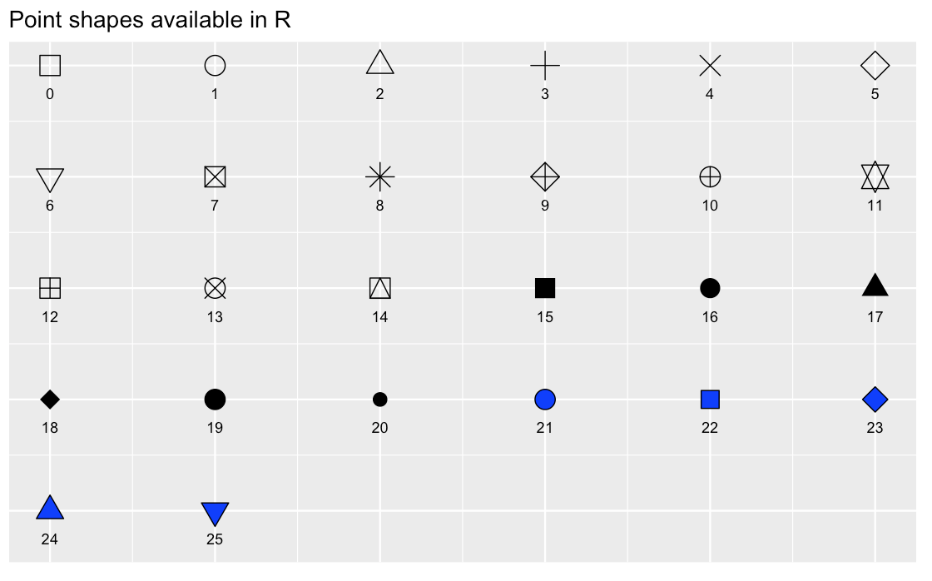
Basic R plotting: scatterplot
plot(x,y)
plot(x,y
xlab =(), #x title
ylab =(), #y title
xlim = c(), #x axis
ylim = c(), #y axis
pch = (), #plotting symbol
las =()#axis label angle
cex.axis =() #axis label magnification/reduction
)
Oxford 2023

Slide 20
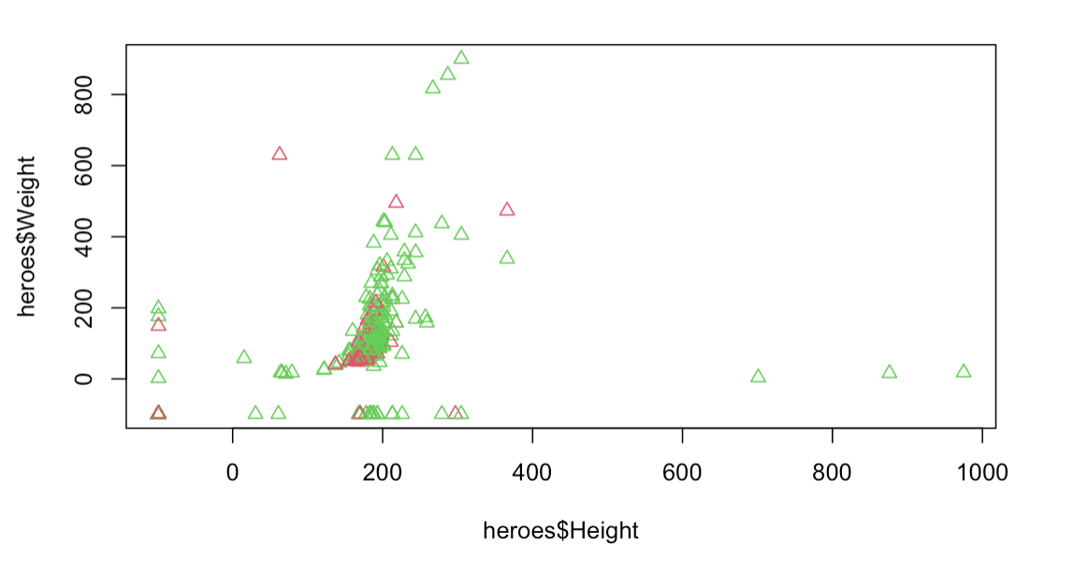
Basic R plotting: scatterplot
plot(heroes$Height, heroes$Weight, col=heroes$Gender, pch=24)
Oxford 2023

Slide 21
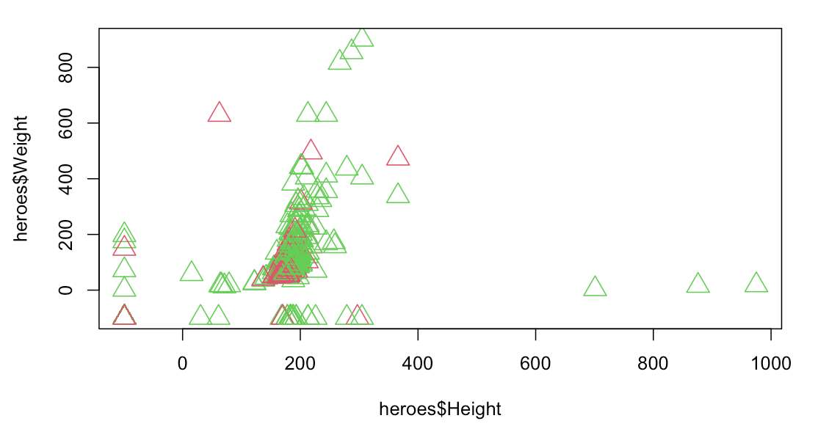
Basic R plotting: scatterplot
plot(heroes$Height, heroes$Weight, col=heroes$Gender, pch=24, cex=2)
Oxford 2023

Slide 22
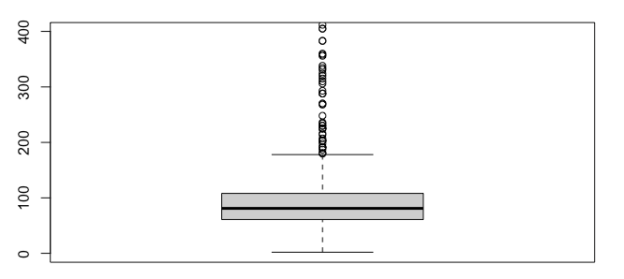
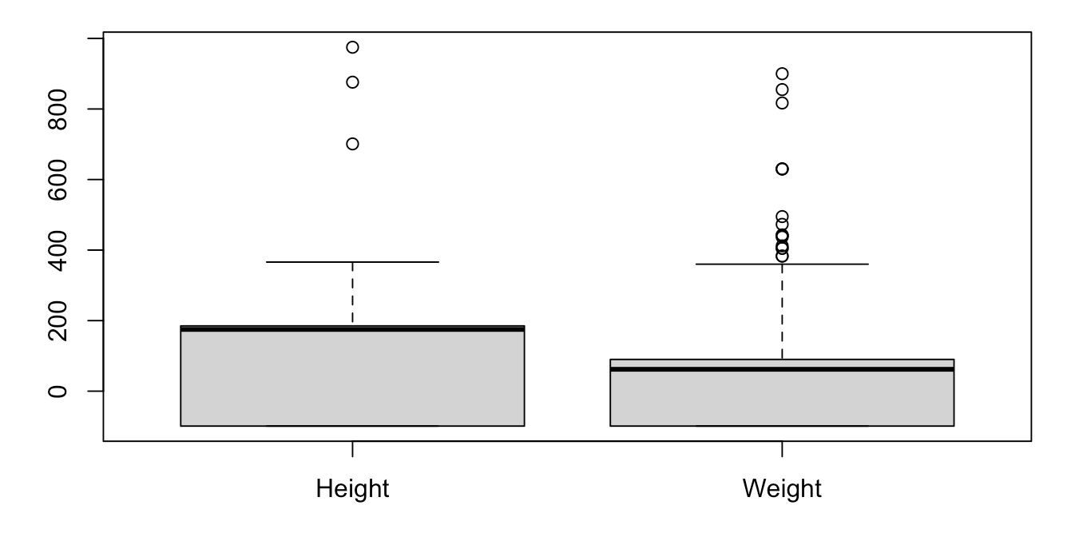
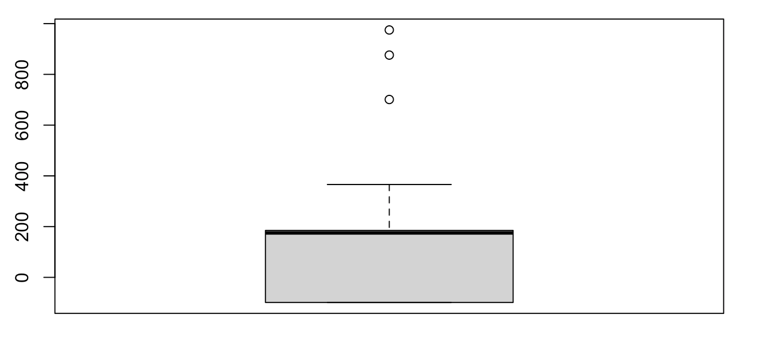
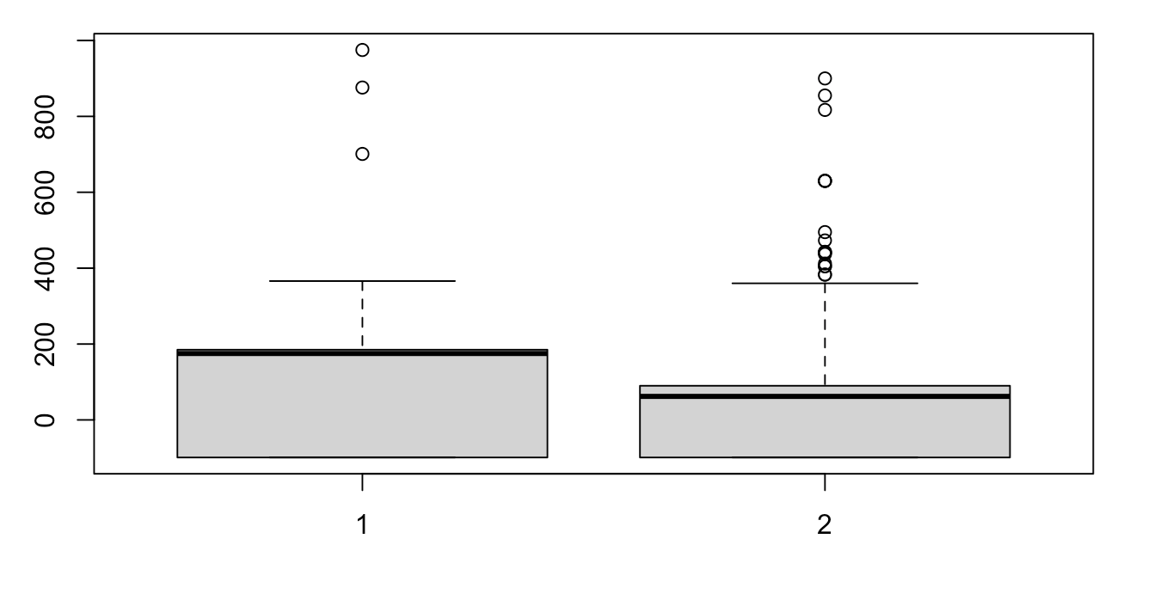
Basic R plotting: boxplots
boxplot(heroes$Height)
boxplot(heroes$Height, heroes$Weight)
boxplot(heroes$Height,heroes$Weight, names=c("Height", "Weight"))
Oxford 2023

Slide 23
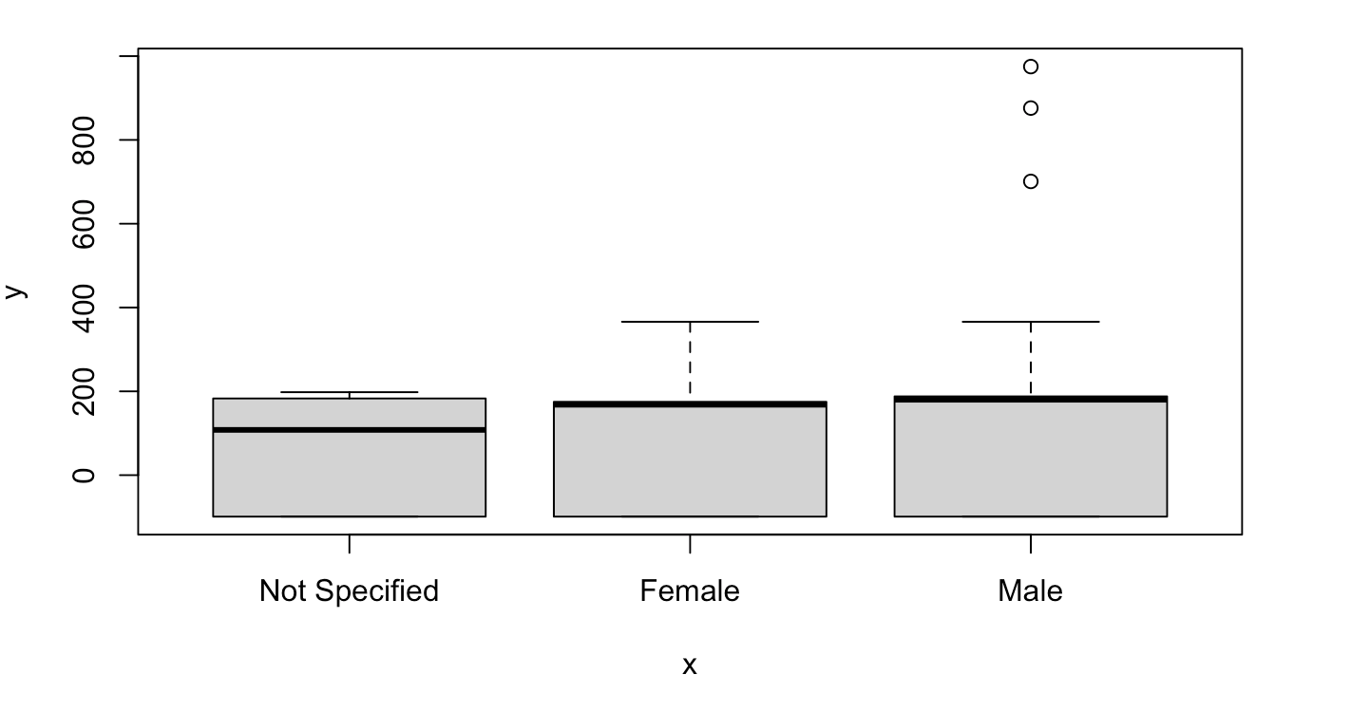
Basic R plotting: boxplots
plot(heroes$Gender, heroes$Height)
Oxford 2023

Slide 24
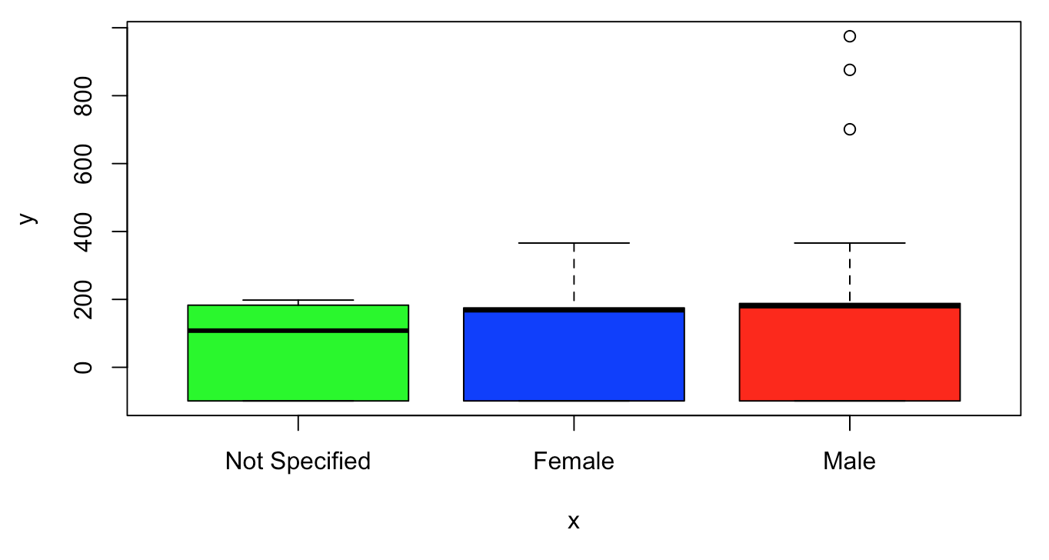
Basic R plotting: boxplots
plot(heroes$Gender, heroes$Height, col=c("green","blue", "red"))
Oxford 2023

Slide 25
Basic R plotting: add legend()
plot(heroes$Height, heroes$Weight, col=heroes$Gender, pch=24, cex=2)
Oxford 2023

Slide 26
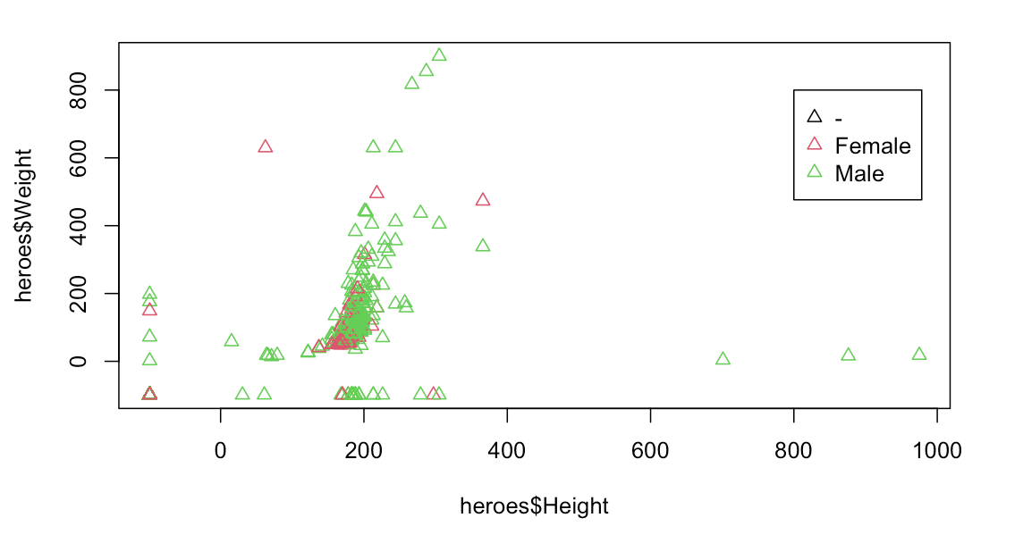
Basic R plotting: add legend()
plot(heroes$Height, heroes$Weight, col=heroes$Gender, pch=24, cex=2)
legend(x=800, y=800, legend = levels(heroes$Gender), col=c(1:3), pch= 24)
Oxford 2023

Slide 27
How to visualize plots
Directly in Rstudio
For quick visualization and exploratory analysis
Depending on type of file used can be seen in the output directly on the source pane (Rmarkdown) or in the output window.
Export and save as pdf, png...
Functions pdf(), png(), bmp(), jpeg()
dev.off
Oxford 2023

Slide 28
Basic R plotting: help
help()
The R Graph Gallery
If you don’t know something: google it!
Oxford 2023

Slide 29
Let´s practice!
Image by lucabravo on Freepik

Slide 30
Limitations base graphics
You could do anything you require in base graphics, BUT:
Some common actions are not that straightforward
Legends
Error bars
Formatting axes
More complex graphs are time-consuming
So the recommendation is:
Base R graphs for quick and basic exploratory analysis
ggplot2 best for anything else
So…. What is ggplot2?
Oxford 2023

Slide 31
Plotting with ggplot2
Plotting package. It is part of the tidyverse package so it can be installed by:
install.packages(“tidyverse”):collection of R packages designed for data science that includes ggplot2.
install.packages(“ggplot2”)
Remember to always load package with library(ggplot2)
Oxford 2023

Slide 32
Plotting with ggplot2: all about layers
Decomposes graphics into layers:
Data
Mapping
Statistics
Scales
Geometries
…
ggplot()
Most basic/important layers: data, mapping (aesthetics) & geometry.
data
mapping
Informs to ggplot2 to understand the dataset (where to grab de info from)
Links variables in data to graphical properties in the geometry
geometry
How to interpret aesthetics
Determines mainly the plot type
Theme
Geometry
ggplot(data = …, mapping = aes()) + geom_function()
Mapping
Data
Oxford 2023

Slide 33

Plotting with ggplot2
install.packages(“ggplot2”)
library(ggplot2)
ggplot()
Oxford 2023

Slide 34
Plotting with ggplot2
ggplot function needs information about: the data (data=…), aesthetics(aes=….) and geometry.
ggplot()
Oxford 2023

Slide 35
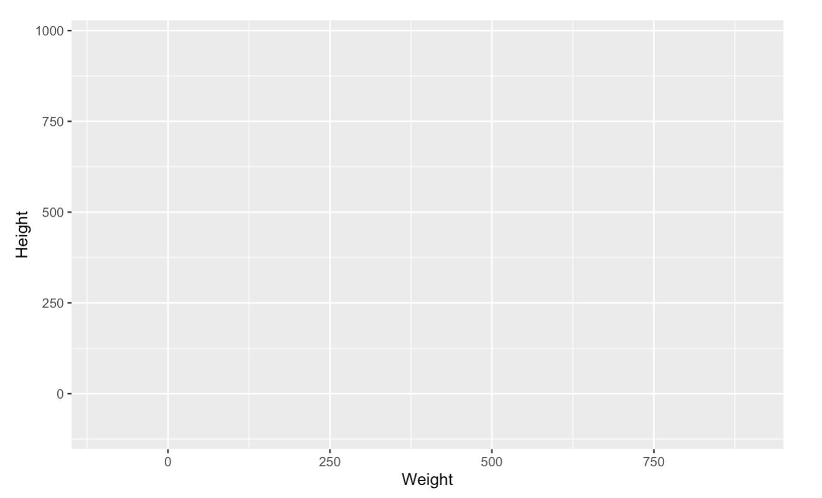
Plotting with ggplot2: data and mapping
ggplot(data = heroes, mapping = aes(Weight,Height))
We haven’t told still to ggplot how to plot data!
Oxford 2023

Slide 36
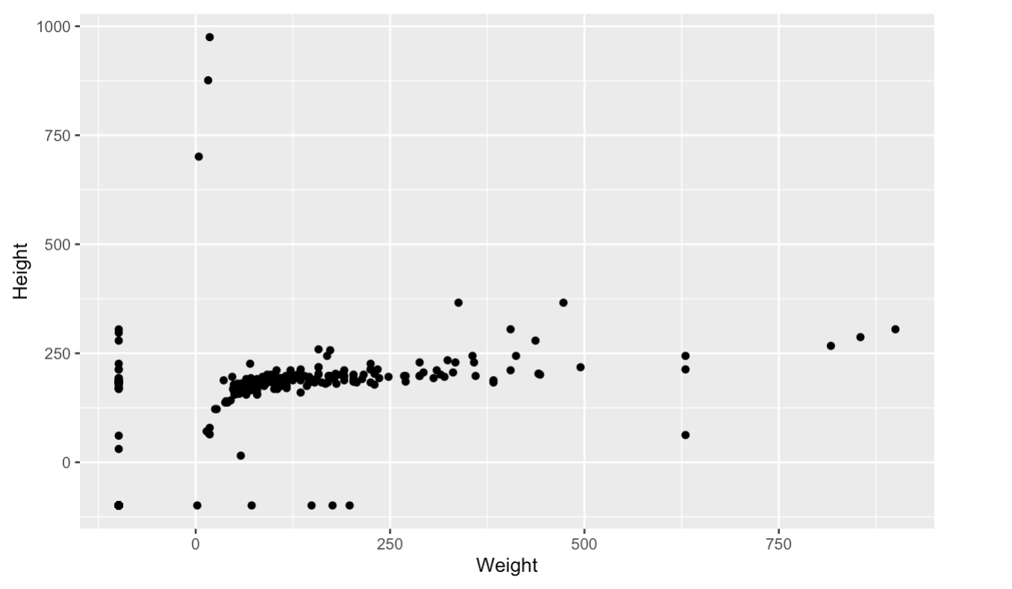
Plotting with ggplot2: geometry
Data to display
ggplot(data = heroes, mapping = aes(Weight,Height))+
geom_point()
Variables to display
Geometry info will say how to display the data
How to display
Oxford 2023

Slide 37
Plotting with ggplot2: geometry
ggplot(data = heroes)+
geom_point(mapping = aes(Weight,Height))
In this case the global data is defined but the mapping is specific to the layer geom and will not be inherited to the following layers.
Oxford 2023

Slide 38
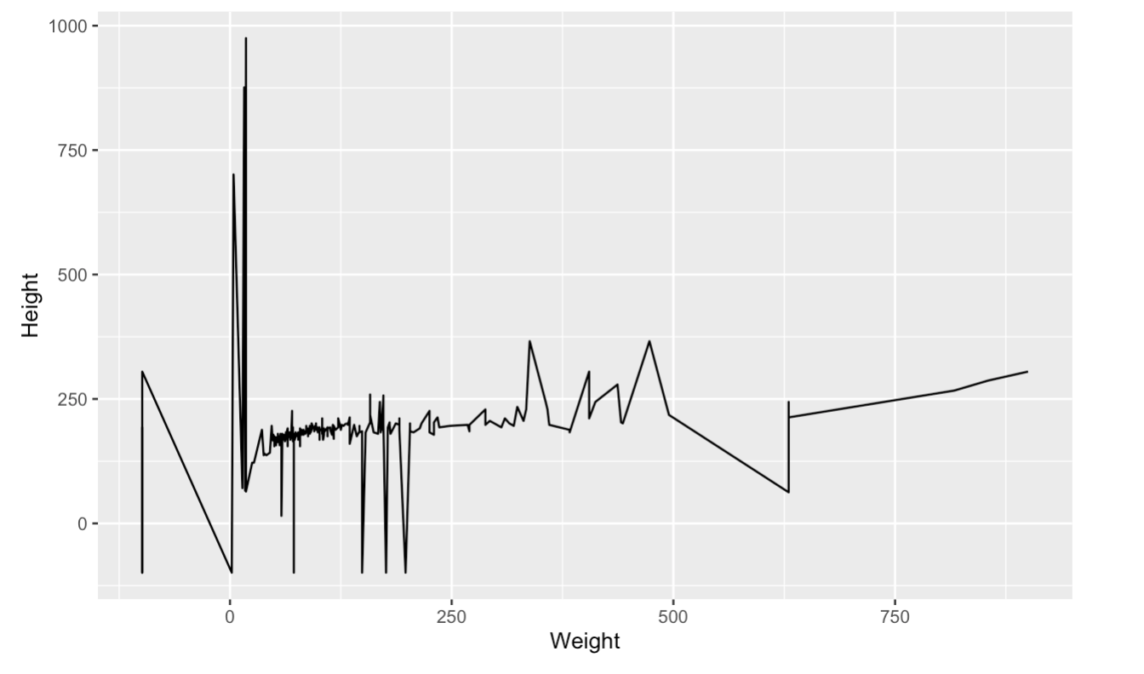
Plotting with ggplot2: geometry
New layer
ggplot(data = heroes, mapping = aes(Weight,Height))+
geom_line() # adding geometry will display data
Geometry info will say how to display the data
Oxford 2023

Slide 39
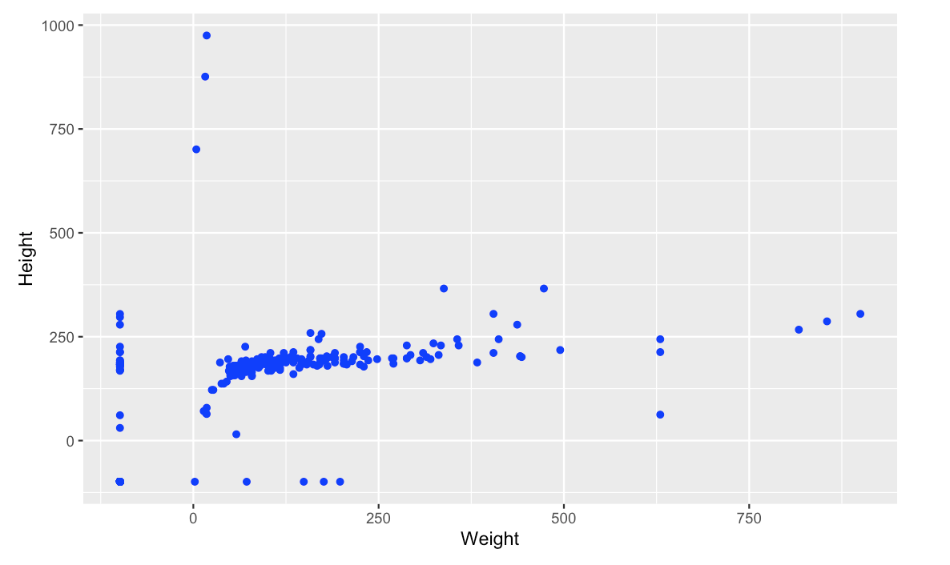
Plotting with ggplot2: geometry
Data to display
ggplot(data = heroes, mapping = aes(Weight,Height))+
geom_point(colour = ”Blue”))
Variables to display
How to display
Oxford 2023

Slide 40
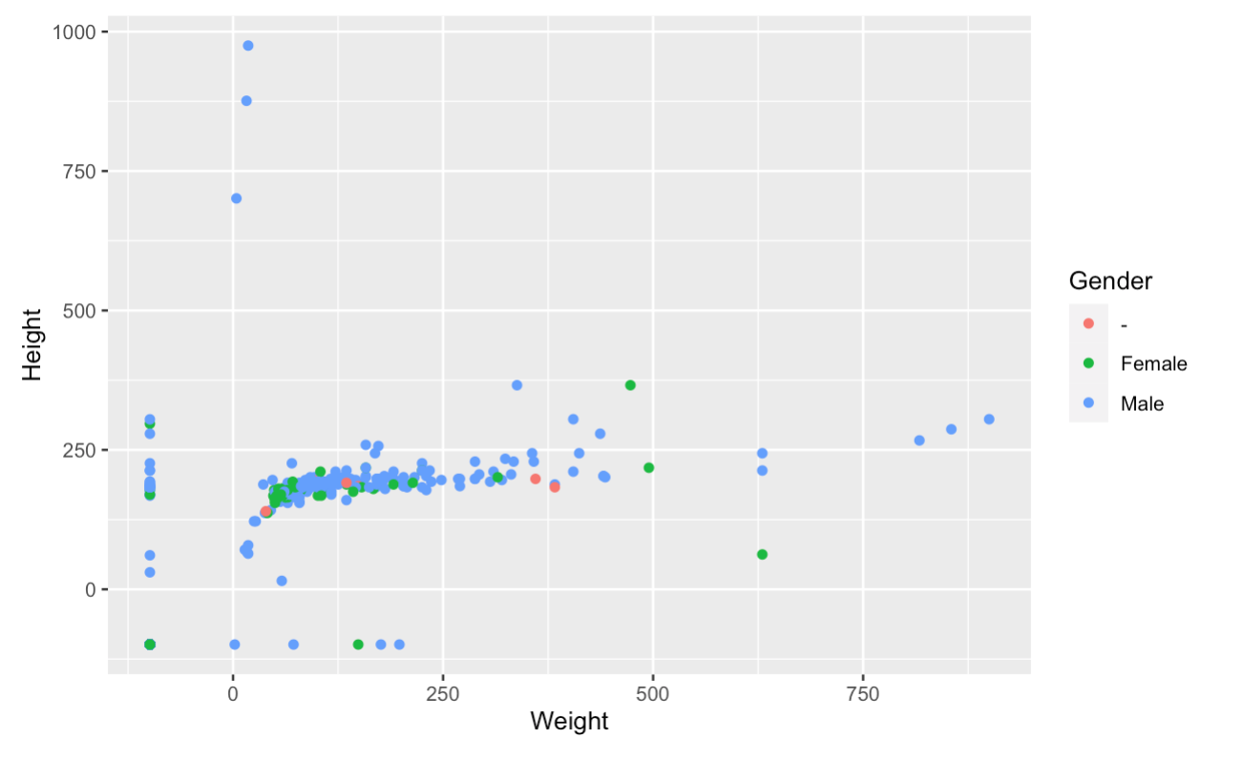
Plotting with ggplot2: geometry
ggplot(data = heroes, mapping = aes(Weight,Height))+
geom_point(aes(colour = Gender))
Automatic created legend
Oxford 2023

Slide 41
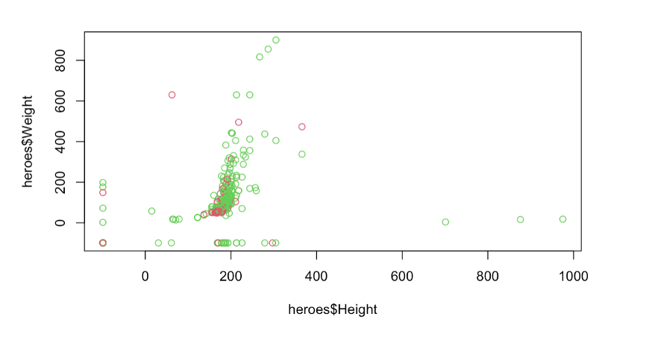
plot(heroes$Height, heroes$Weight, col=heroes$Gender)
ggplot(data = heroes, mapping = aes(Weight,Height))+
geom_point(aes(colour = Gender))
Oxford 2023

Slide 42
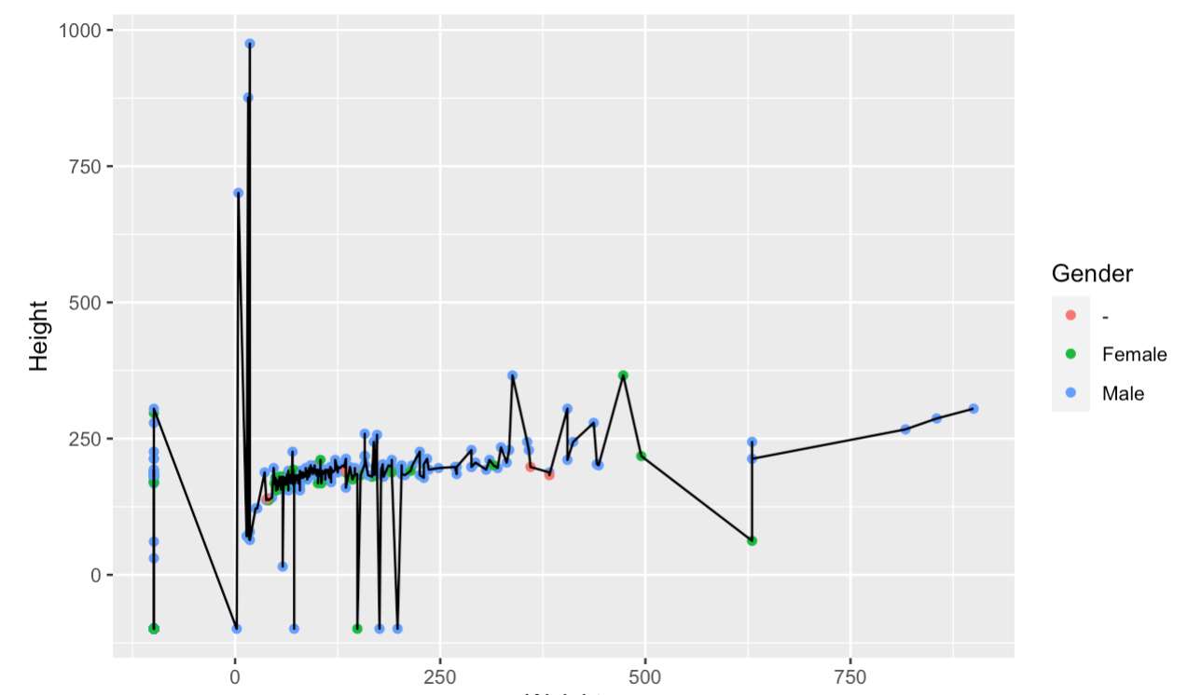
Plotting with ggplot2: geometry
New layer
ggplot(data = heroes, mapping = aes(Weight,Height))+
geom_point(aes(colour = Gender))+
geom_line()
New layer
Geometry info will say how to display the data. We can add several layers.
Oxford 2023

Slide 43
Plotting with ggplot2: geometry
New layer
ggplot(data = heroes, mapping = aes(Weight,Height))+
geom_point(aes(colour = Gender))+
geom_line()
New layer
No need to specify data and mapping
No need to specify data and mapping
ggplot(heroes, aes(Weight,Height)) +
geom_point(aes(colour = Gender)) +
geom_line()
Get help on Rstudio: look for geom_point in help
Oxford 2023

Slide 44
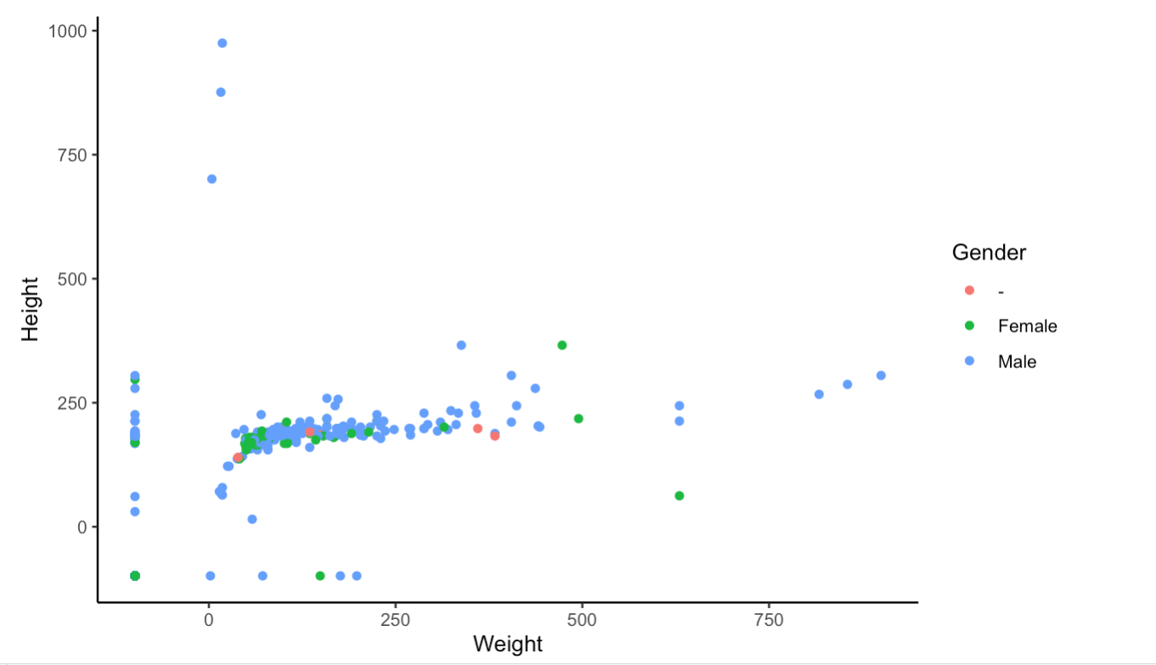
Plotting with ggplot2: themes
ggplot(data = heroes, mapping = aes(Weight,Height))+
geom_point(aes(colour = Gender))+
theme_classic()
Predefined themes that control general style
Oxford 2023

Slide 45
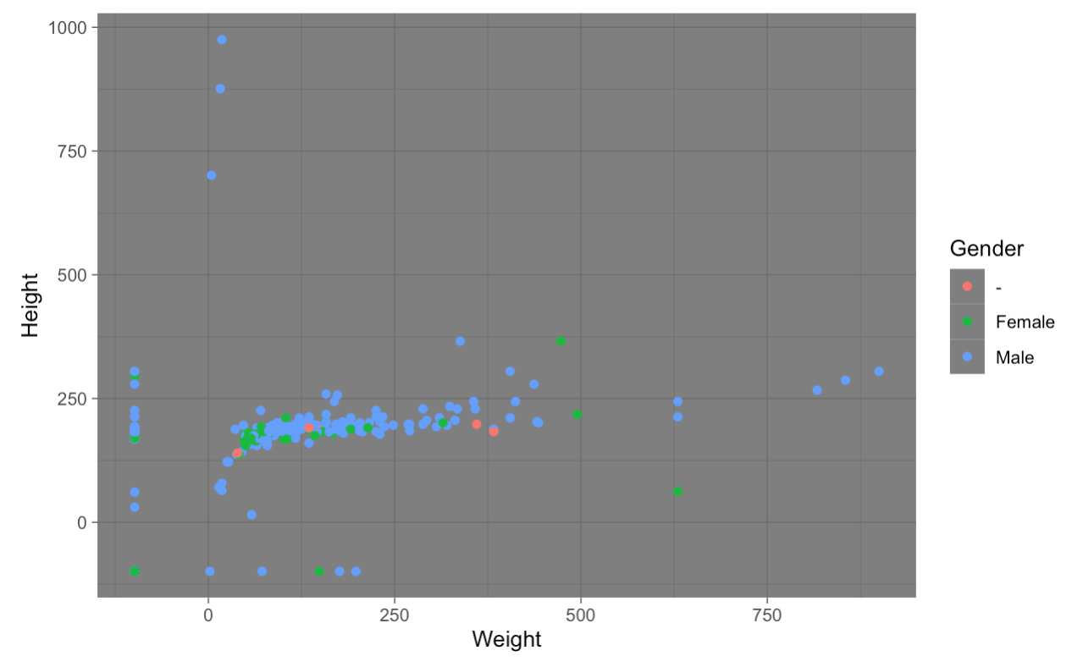
Plotting with ggplot2: themes
ggplot(data = heroes, mapping = aes(Weight,Height))+
geom_point(aes(colour = Gender))+
theme_dark()
Predefined themes that control general style
Oxford 2023

Slide 46
Plotting with ggplot2: facets
Take data and divides it in multiple panels.
Each panel uses same mapping, scales and so on but splits the data.
Necessary to avoid overplotting when there is too much data
Oxford 2023

Slide 47
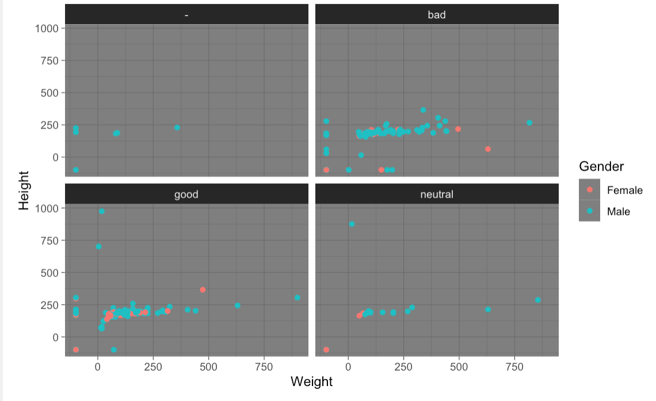
Plotting with ggplot2: facet_wrap
Takes data and splits them using a variable/column from your data to create smaller subplots
ggplot(data = heroes, mapping = aes(Weight,Height))+
geom_point(aes(colour = Gender))+
theme_dark()+
facet_wrap(~Alignment)
Easier to compare!
Oxford 2023

Slide 48
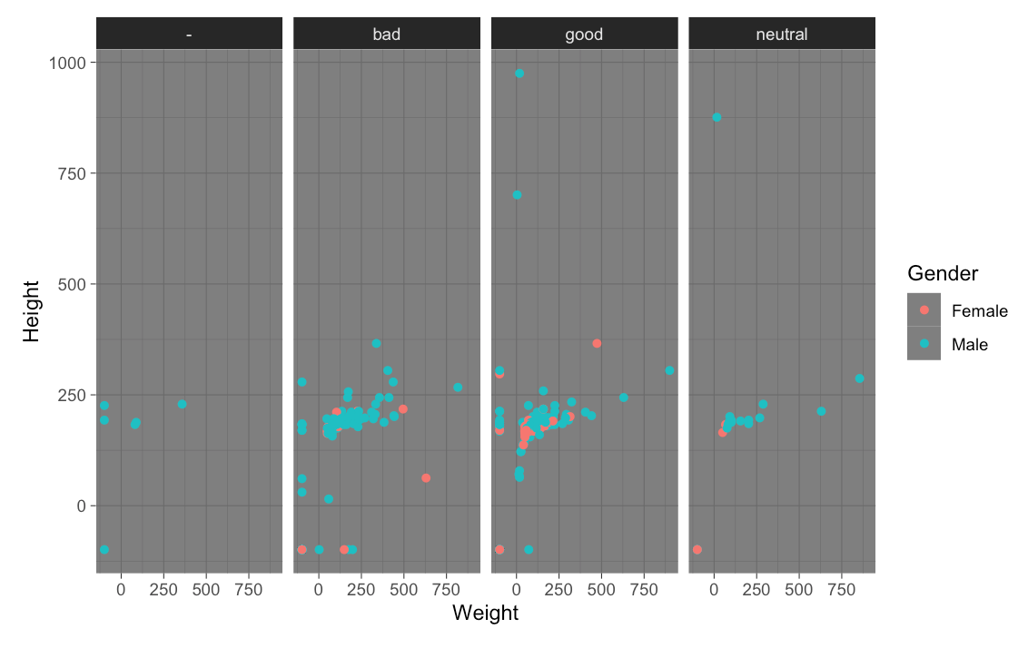
Plotting with ggplot2: facet_grid
Takes data and splits them using a variable/column from your data to create smaller subplots
ggplot(data = heroes, mapping = aes(Weight,Height))+
geom_point(aes(colour = Gender))+
theme_dark()+
facet_grid(~Alignment)
Oxford 2023

Slide 49
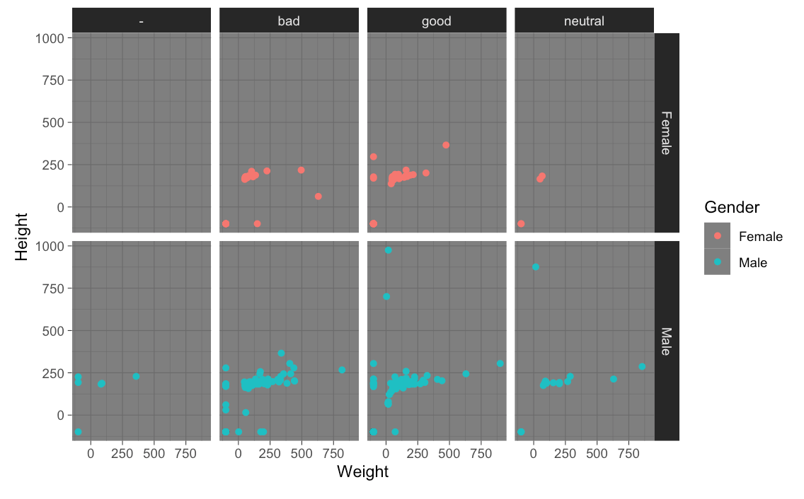
Plotting with ggplot2: facet_grid
Can take 2 variables to create smaller subplots which represent the intersection between the two.
ggplot(data = heroes, mapping = aes(Weight,Height))+
geom_point(aes(colour = Gender))+
theme_dark()+
facet_grid(Gender~Alignment)
Oxford 2023

Slide 50
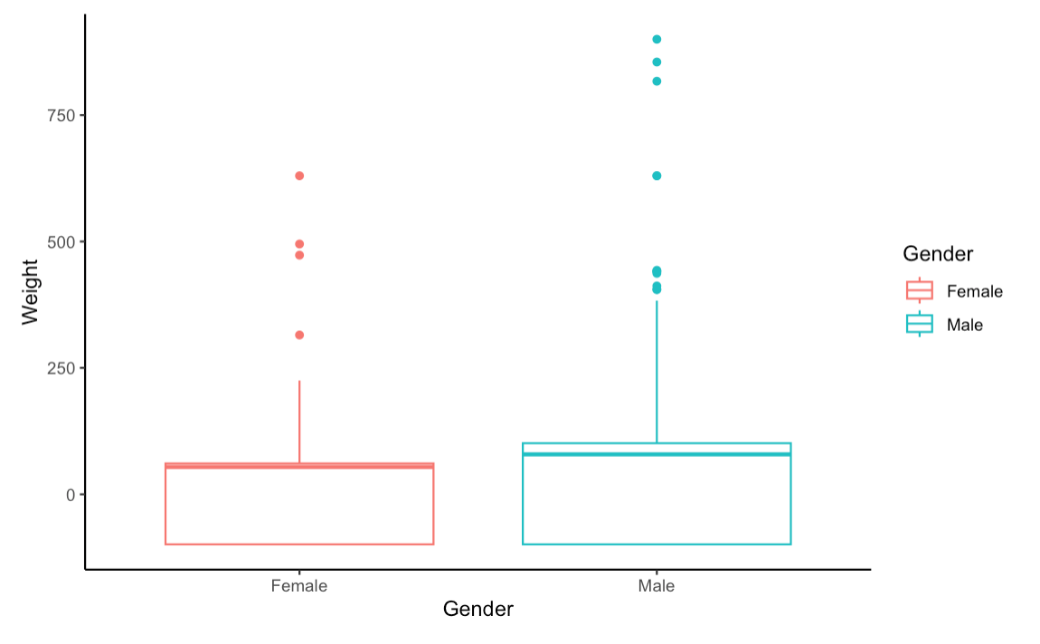
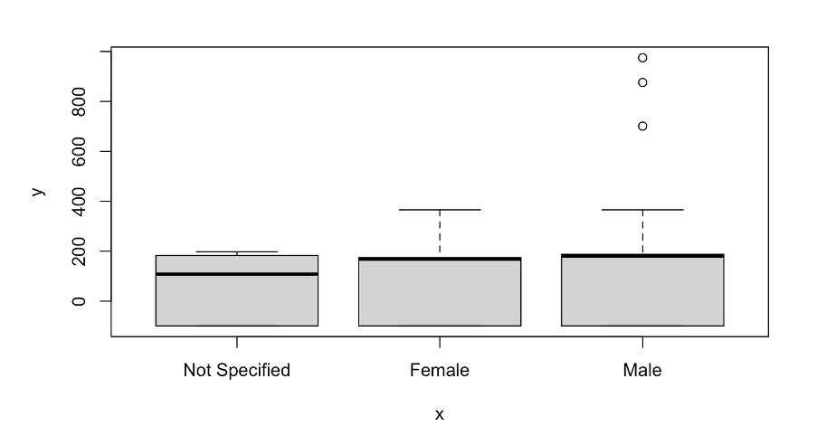
Plotting with ggplot2: boxplots
ggplot(data = heroes, mapping = aes(Gender,Weight)) +
geom_boxplot(aes(colour=Gender)) +
theme_classic()
Oxford 2023

Slide 51
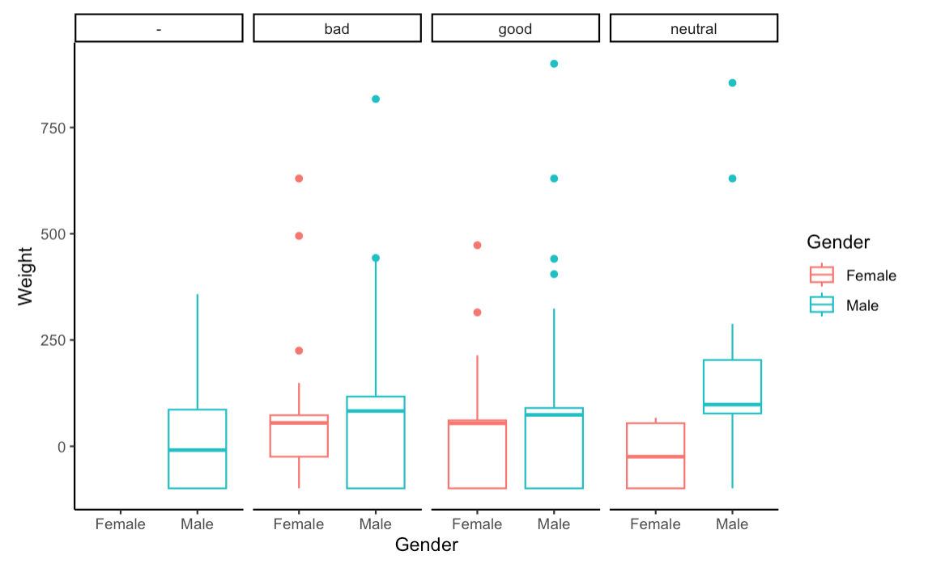
Plotting with ggplot2: facets
ggplot(data = heroes, mapping = aes(Gender,Weight)) +
geom_boxplot(aes(colour=Gender))+
theme_classic()+
facet_grid(~Alignment)
Oxford 2023

Slide 52
ggplot2: save as a variable/object
myplot = ggplot(data = heroes, mapping = aes(Gender, Weight)) +
geom_boxplot(aes(colour=Gender)) +
theme_classic() +
facet_grid(~Alignment) +
ggtitle (”myplot")
print(myplot)
Oxford 2023

Slide 53
ggplot2: export using ggsave()
ggsave("myplot.pdf")
ggsave("myplot.png")
ggsave("myplot.pdf", width = 10, height = 5)
ggsave("exported_plot.pdf",
plot = myplot, width = 10, height = 5)
Oxford 2023

Slide 54
ggplot2: export without ggsave()
Graphs can also be saved writing directly to a graphics device:
pdf("myplot.pdf")
print(myplot)
dev.off()
If working from RScript then we can directly import from the outcome window
Oxford 2023

Slide 55
Plotting with ggplot2: resources
ggplot2 documentation
https://ggplot2.tidyverse.org/
Data Visualisation chapter in R for Data Science
https://r4ds.had.co.nz/data-visualisation.html
Graphics for communication chapter in R for Data Science
https://r4ds.had.co.nz/graphics-for-communication.html
The R Graph Gallery
https://r-graph-gallery.com/
Oxford 2023

Slide 56
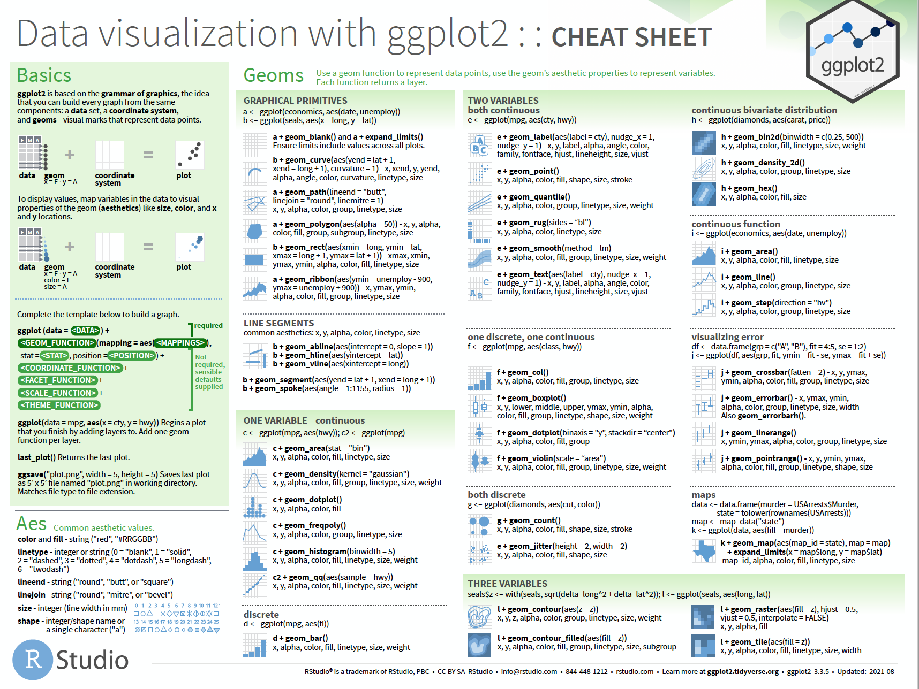
Plotting with ggplot2: resources
https://ggplot2.tidyverse.org

Slide 57
Plotting with ggplot2: ask for help
RStudio community
https://community.rstudio.com/
Stack Overflow
https://stackoverflow.com/questions/tagged/ggplot2?sort=frequent&pageSize=50
Ggplot2 cheat sheet
https://ggplot2.tidyverse.org/
Oxford 2023

Slide 58
Let´s practice!
Image by lucabravo on Freepik

Slide 60
HANDLING MISSING VALUES
Thursday 6th July
Oxford 2023

Slide 61
Nas/NaN
NA/NaN are used to define missing values.
This happen when there is no data or insensible or impossible arithmetic operations are tried.
Finding/test missing data: is.na()/is.nan()
Filtering missing data:
na.omit()- rules out any rows containing missing value
Careful! Sometimes missing data comes in other forms as “-” , 0 or “not specified”. These probably need recoding.
Oxford 2023

Slide 62
Let´s practice!
Image by lucabravo on Freepik

Slide 63
CONDITIONALS
Thursday 6th July
Oxford 2023

Slide 64
Conditionals:
Useful when you do not want to execute one statement after another but to have control over the flow of execution also.
Determine if a specified condition is met (or not) then direct subsequent analysis or action depending on the result
There are basic conditionals and syntax in R
if → if (condition) statement
If…else → if (condition) statement 1 else statement 2
ifelse → ifelse (condition, yes, no)
Oxford 2023

Slide 65
Conditionals: if statements
If produces a logical value from the condition and carries out the next statement only when the value becomes TRUE.
If statements are a Boolean expression followed by a single or multiple statements.
Condition: any expression that evaluates TRUE or FALSE.
if (condition) {
do something
}
x = 6
if (x > 4) {
print(“Number higher than 4”)
}
?
x > 4
condition
TRUE
print(“Number higher than 4”)
statement
Oxford 2023
Number higher than 4

Slide 66
Conditionals: if…else statements
If statements are followed by an optional ”else” statement that gets executed when the Boolean expression becomes false.
if (condition) {
do something if condition is true, this happens (TRUE branch)
} else {
do something else if condition is false, this happens (FALSE branch)
}
x = 6
if (x > 8) {
print(“Number higher than 8”)
}else{
print(“Number lower than 8”)
}
?
x > 8
condition
FALSE
TRUE
print(“Number lower than 8”)
print(“Number higher than 8”)
statement B
statement A
else block (FALSE BRANCH)
If block (TRUE BRANCH)

Slide 67
Conditionals: chained conditionals (else if)
if (condition A is TRUE) {
do something (statement A)
} else if (condition B is TRUE) {
do something else (statement B)
} else {
do something else (statement C)
}
x = 0
if (x > 0) {
print(“Positive number”)
}else if (x < 0){
print(“Negative number”)
} else {
print(“Zero”)
}
If first condition is true, statement A is executed
New condition to test if previous one was false
False branch.
Executed if none of the conditions above are true
Oxford 2023

Slide 68
Conditionals: chained conditionals (else if)
if (condition A is TRUE) {
do something (statement A)
} else if (condition B is TRUE) {
do something else (statement B)
} else {
do something else (statement C)
}
x = 0
if (x > 0) {
print(“Positive number”)
}else if (x < 0){
print(“Negative number”)
} else {
print(“Zero”)
}
Condition A
TRUE
statement A
FALSE
Condition B
TRUE
statement B
FALSE
statement C
Oxford 2023

Slide 69
Conditionals: ifelse() function
Conditional statements are not vector operations, they deal only with a single value.
If we pass the if statement to a vector it will generate a warning.
ifelse() function checks the condition for every element of a vector and selects elements from the specified vector depending upon the result
Syntax:
ifelse(condition, TrueBranch, FalseBranch)
Oxford 2023

Slide 70
Let´s practice!
Image by lucabravo on Freepik

Slide 71
LOOPS
Thursday 6th July
Oxford 2023

Slide 72
Loops
Programming instruction that repeats a chunk of code until a specific condition is reached. The loop executes a code block again and again until no further action is required.
Iteration: repetition of a process. Each time the code block within the code is executed is called iteration.
Loops are great tools to play around with code and gain a deeper understanding of R.
We will see for loops and while loops
Oxford 2023

Slide 73
Loops: for-loops
Used to iterate over a sequence.
Perform same action for each item in a list of things.
Syntax:
for (val in sequence)
{
statement
}
Where the sequence can be a vector or a list and val takes a different value each time during the loop. The same statement is evaluated in every iteration.
Oxford 2023

Slide 74
Loops: for-loops
genes = c(“PI3K”, “FOXO”, “VLDL”, ”LIPC”)
for (val in genes)
{
print(val)
}
[1] "PI3K”
[1] "FOXO"
[1] "VLDL"
[1] "LIPC"
Oxford 2023

Slide 75
Loops: while-loops
Used to iterate indefinitely as long as certain logical condition is TRUE.
It is called condition-controlled loop.
Syntax:
while (condition)
{
statement
}
Loop body. Executed as long as condition is TRUE
Oxford 2023

Slide 76

Loops: while-loops
x = 0
while (x < 10)
{
x = x + 1
print (x)
}
[1] 1
[1] 2
[1] 3
[1] 4
[1] 5
[1] 6
[1] 7
[1] 8
[1] 9
[1] 10
condition
FALSE
TRUE
statement
Exit loop
Oxford 2023

Slide 77
Let´s practice!
Let´s practice!
Image by lucabravo on Freepik

Slide 78
FUNCTIONS
Friday 7th July
Oxford 2023

Slide 79
Functions
Set of statements organized together to perform a specific task.
R has a large number of in-built functions. Everything is a function really!
Syntax:
function.name = function (arg1, arg2, …)
{
function body
}
Oxford 2023

Slide 80
Let´s practice!
Let´s practice!
Image by lucabravo on Freepik

Slide 82
Understanding boxplots
Potential outliers
25%
Upper whisker
Upper quartile
(75th percentile)
25%
median
Inter quartile
25%
Lower quartile
(25th percentile)
25%
Lower whisker
Oxford 2023

Slide 83
Oxford 2023

